Slide 1

IncubateIND Covid19
Hackathon Idea Submission and
Proposed Solution
SUBMITTED BY:
Mr. Shailendra Kumar Mishra
Ph.D Scholar, A80166220004 (batch 2)
Amity School of Engineering and Technology
Amity University Chhattisgarh, Raipur
IncubateIND Covid-19 Hackathon

Slide 2
Contents
Problem Statement
Proposed Solution
Approach
Proposed Workflow
Expectations
Result Analysis
IncubateIND Covid-19 Hackathon

Slide 3
Problem Statement
To come up with solutions by utilizing heatmaps, like geotagging high risk zones and marking those through heatmaps, or in other ways and use clusters to markdown the fake news and its origin.
IncubateIND Covid-19 Hackathon

Slide 4
Proposed Solution
Using Data analysis tool like R, XL miner, Python, Rapid Minor to perform statistical analysis of Covid-19, structured and unstructured data received from various sources i.e official and social media.
IncubateIND Covid-19 Hackathon

Slide 5
Approach
The major challenges and opportunities related to the Covid-19 data collection from authentic sources, preprocessing, monitoring and processing for result.
The proposed solution can handle the different multidimensional views for example: they can contain a count for the number of times that data occurs in the database, or the minimum, maximum, sum or average value of some set of data.
IncubateIND Covid-19 Hackathon

Slide 6
Approach…
To improve performance of the data analysis, OLAP (Online Analytical Processing) and ROLAP (Relational Online Analytical Processing) operations are performed on the multidimensional data sets to retrieve decision support information using data cube operational methods.
Use of different concepts and examine the statistical data from various approaches to detect the high risk zone and news origin related to Covid-19.
IncubateIND Covid-19 Hackathon

Slide 7
Approach…
Key elements of the idea proposed
I. Data Collection and Validation:
In the era of 21st century the data is generated through various sources. Different types of data is generated about covid-19 day by day from the various official as well as unofficial sources. The data set is collected from the authentic sources i.e. https://www.mygov.in/covid-19 and timely synchronized with it for the analysis purpose. The collection process involves data size, data attributes, time frame etc. https://ieeexplore.ieee.org/stamp/stamp.jsp?tp=&arnumber=8428412. Collected data is utilized to validate effort values and also help in identifying the critical points where Covid effects are more.
IncubateIND Covid-19 Hackathon

Slide 8
Approach…
Key elements of the idea proposed
II. Data Analytics Tools/Methods:
The proposed effective solution using supportive evidence implements the visualization features, Text mining and Predective analysis, Analyze time series data using ACF/PACF plots and smoothing techniques.
IncubateIND Covid-19 Hackathon

Slide 9
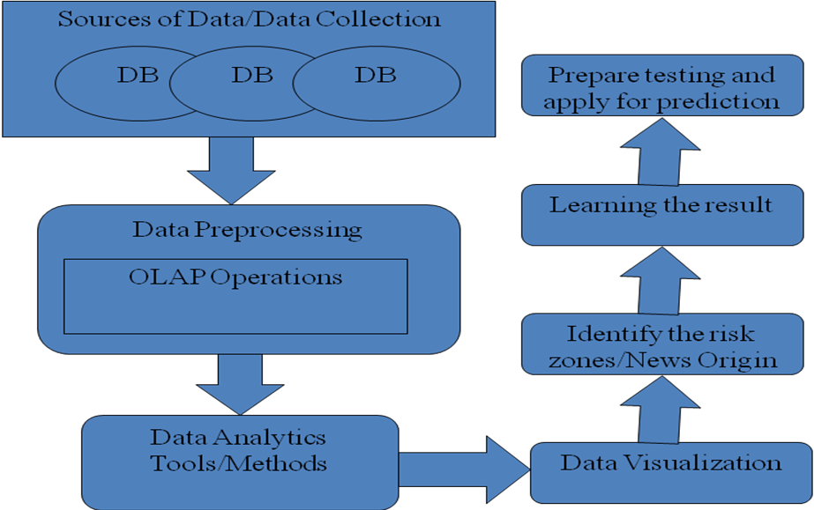
Proposed Workflow
IncubateIND Covid-19 Hackathon

Slide 10
Expectations
i) Increasing understanding of the disease using real data of Covid-19
ii) Authentic the real data and fake data
iii) Data source generation and its impact on result dimensionally
iv) Data visualization through GeoTagging model/R-Visualization
v) Helpful for the rapid detection and response to cases, clusters and
community transmission.
IncubateIND Covid-19 Hackathon

Slide 11
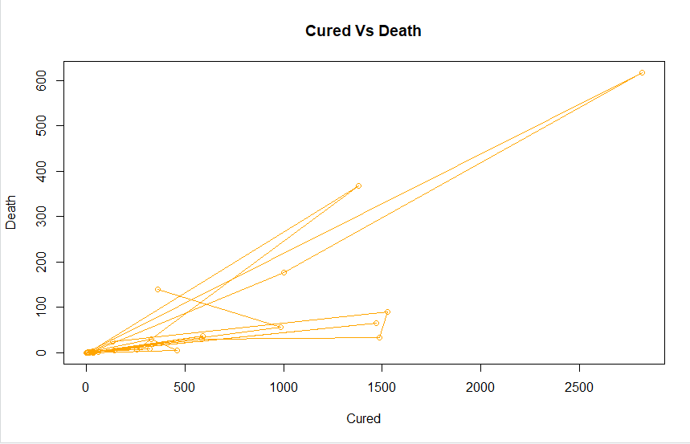
Result Analysis
The generated line graph represents relationship between Cured and Death Patients. This ratio is higher in some places and required more attention and medical staff to overcome.
IncubateIND Covid-19 Hackathon

Slide 12
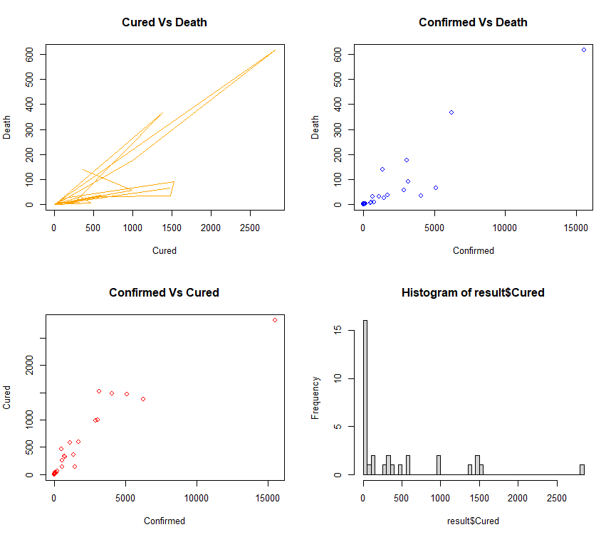
Result Analysis
The generated graphs represents relationship between Confirmed/Death Patients and Confirmed/Cured Patients. The Confirmed/Death ratio is higher in some places and required more attention and medical staff to overcome whereas Confirmed/Cured represents the effectiveness of the method/model implemented to solve the purpose.
The histogram represents the number of the patients cured in given time interval, which shows the frequency per treated patients and effectiveness of the treatment over the mass crowd.
IncubateIND Covid-19 Hackathon

Slide 13
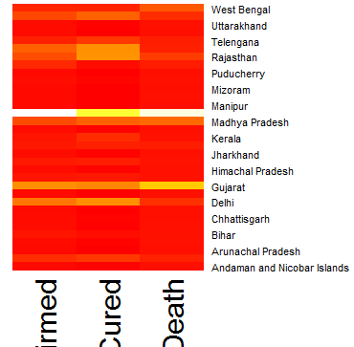
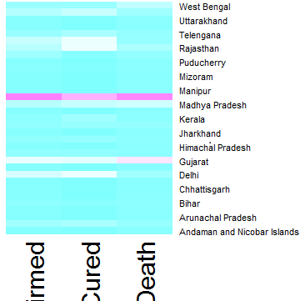
Result Analysis
The generated heat maps represents state wise density of confirmed/cured/death patients, which will help the government to take necessary actions over the more dense areas (represented by thick color layer) of confirmed and death cases like extending lock down, provide more medical facilities etc.
IncubateIND Covid-19 Hackathon

Slide 14



IncubateIND Covid-19 Hackathon

